Slide 1
Character Generation

Slide 2
Character Generation
Letters, numbers, and other character are often displayed to label and annotate drawing and go give instructions and information to the user.
Most of the times characters are built into the graphics display devices, usually as hardware but sometimes through software.

Slide 3
There are basic three methods for charcter generation:
Stroke method
Starbust method
Bitmap method

Slide 4
1. Stroke method
This method uses small line segments to generate a character.
The small series of line segments are drawn like a strokes of a pen to form a character as shown in figure.

Slide 5
We can build our own stroke method.
By calling a line drawing algorithm.
Here it is necessary to decide which line segments are needed for each character and
Then drawing these segments using line drawing algo.
This method supports scaling of the character.
It does this by changing the length of the line segments used for character drawing.

Slide 6
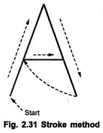

Slide 7
2. Starbust method
In this method a fix pattern of line segments are used to generate characters.
As shown in figure, there are 24 line segments.
Out of 24 line segments, segments required to display for particular character, are highlighted
This method is called starbust method because of its characteristic appearance.

Slide 8
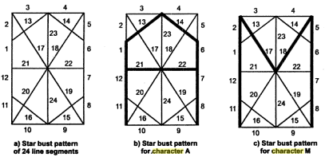
Character A : 0011 0000 0011 1100 1110 0001
Character M:0000 0011 0000 1100 1111 0011

Slide 9
Fig shows the starbust patterns for character A and M.
The patterns for particular characters are stored in the form of 24 bits code.
Each bit representing one line segment.
The bit is set to one to highlight the line segment otherwise it is set to zero.
Character A : 0011 0000 0011 1100 1110 0001
Character M:0000 0011 0000 1100 1111 0011

Slide 10
This method of character generation is not used now a days because of following disadvantages:
The 24-bits are required to represent a character. Hence more memory is required.
Requires code conversion software to display character from its 24 bits code.
Character quality poor. Worst for curve shaped character.

Slide 11
3. Bitmap Method
The third method for character generation.
Also known as dot matrix because in this method characters are represented by an array of dots in the matrix form.
It’s a two dimensional array having columns and rows : 5 X 7 as shown in figure.
7 X 9 and 9 X 13 arrays are also used.
Higher resolution devices may use character array 100 X 100.

Slide 12
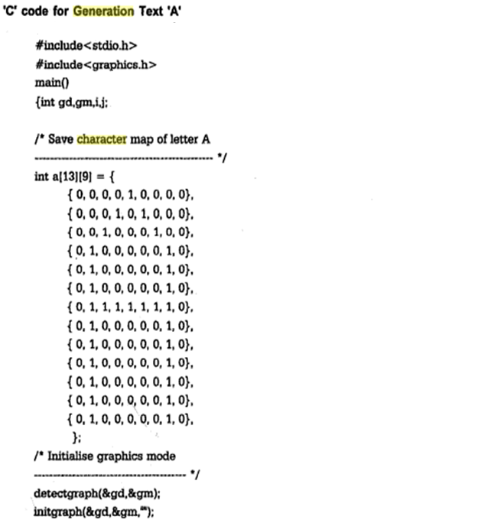
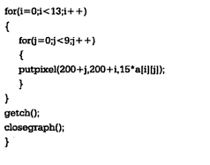
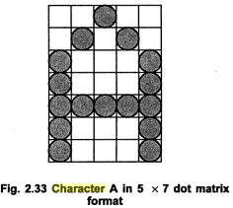

Slide 13
Each dot in the matrix is a pixel.
The character is placed on the screen by copying pixel values from the character array into some position of the screen’s frame buffer.
Value of the pixel controls the intensity of the pixel.
Usually the dot patterns for all characters are stored in the hardware device called a character generation chip.
This chip accepts address for the character and gives the bit pattern for that character as an output.
Here the size of the pixel is fixed and hence the size of the dot.
Characters can be represented in many fonts.
When number of fonts are more, the bit patterns for characters may also be stored in RAM.
Antialiasing is possible in this method.

